Slide 1
Predicting Sleep Disorders
Impact of Lifestyle and Cardiovascular Health
- Vishal Prasanna

Slide 2
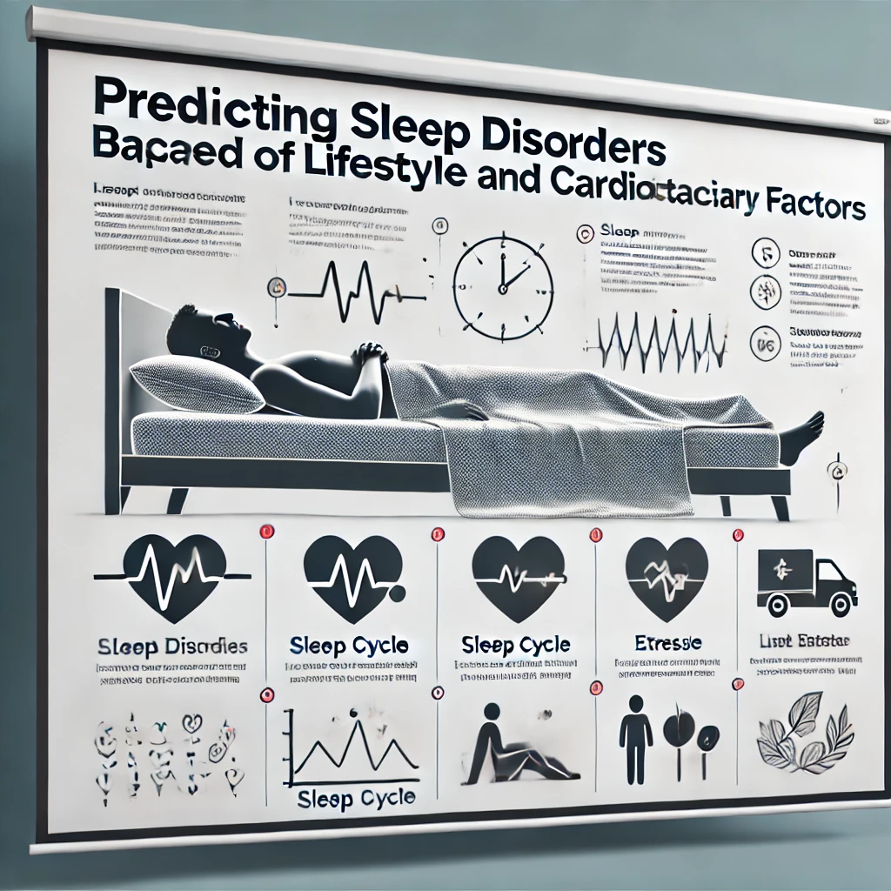
Agenda
Introduction
Problem Statement
Dataset Overview
Motivation
Expected Outcomes

Slide 3

Introduction
The goal is to investigate the relationship between sleep health, lifestyle choices, and cardiovascular factors to identify potential predictors of sleep disorders.

Slide 4

Problem Statement
Sleep disorders are common and can affect overall health. However, the relationship between lifestyle factors and sleep quality is not well understood. We will analyse the Sleep Health and Lifestyle Dataset to explore how lifestyle choices impact sleep duration and quality, examine the prevalence of sleep disorders among different demographic groups, and identify key predictors of these disorders.

Slide 5

Dataset Overview
Key Features
Sleep Metrics: Duration (hours) and Quality (scale 1-10)
Lifestyle Factors: Physical Activity (minutes/day), Stress Level (scale 1-10)
Health Indicators: BMI Category, Blood Pressure, Heart Rate (bpm)
Sleep Disorders: Presence of Insomnia or Sleep Apnea

Slide 6

Motivation
Why This Idea? Sleep quality is essential for health, yet many people suffer from sleep disorders. Understanding how lifestyle factors contribute to sleep issues can help improve health recommendations and personal habits.

Slide 7

Expected Outcomes
Identification of Key Lifestyle Predictors
Quantification of Cardiovascular Health Impact
Demographic Insights
Actionable Health Recommendations

Slide 8
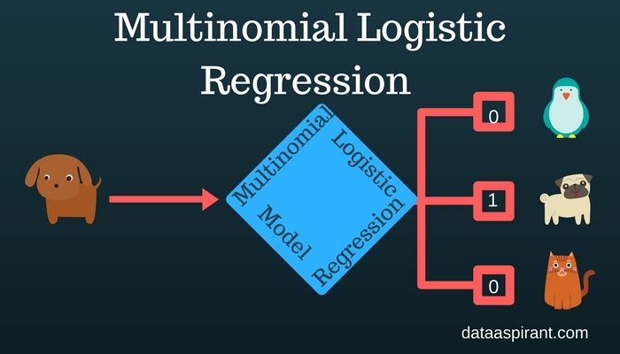
Multinomial Logistic Regression
Multinomial Logistic regression is useful for situations in which you want to be able to classify subjects based on values of a set of predictor variables. This type of regression is similar to logistic regression, but it is more general because the dependent variable is not restricted to two categories.

Slide 9
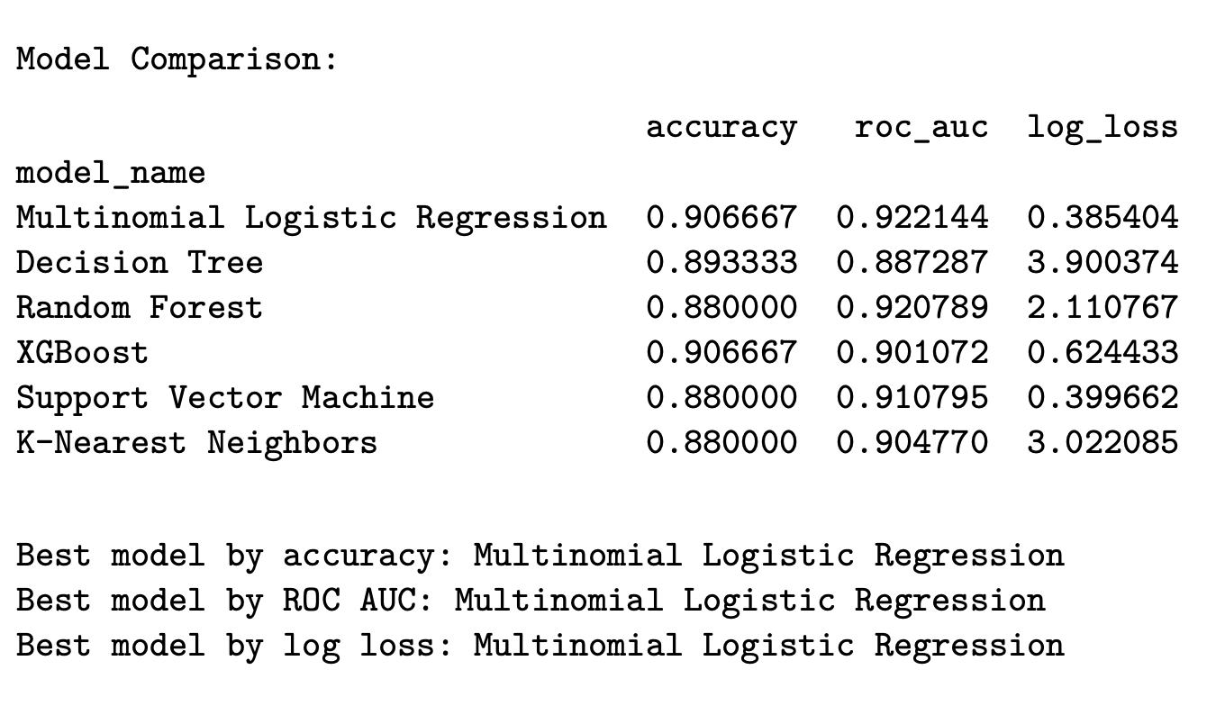

Results of Various Model

Slide 10
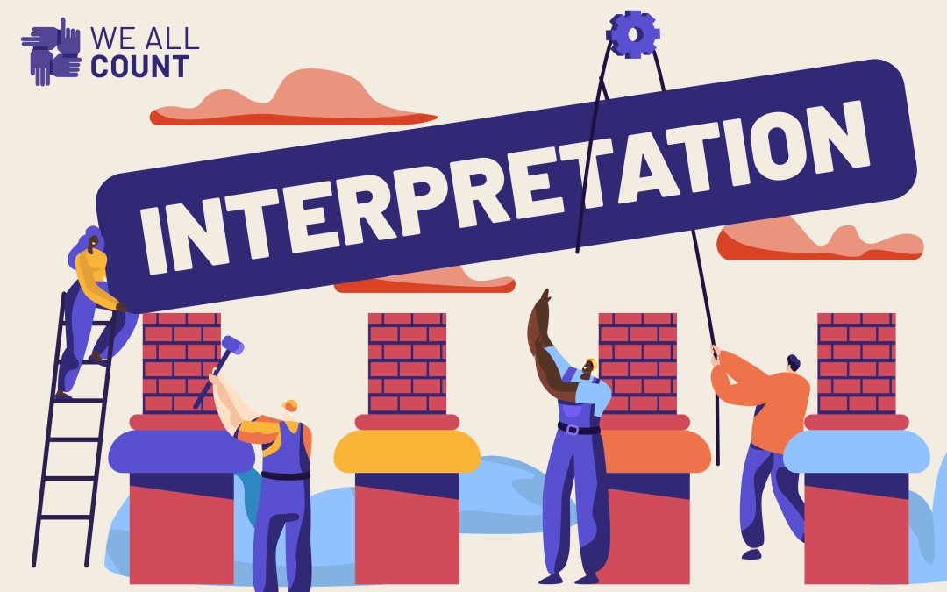
Interpretation
Blood Pressure
Teacher, Salesperson, Nurse, Accountant
Lower Physical Activities
More Stress Level

Slide 11

Potential Uses
Develop targeted wellness programs focused on stress management for the specific groups
Implement awareness initiatives to highlight the importance of physical activity and stress reduction for employees in high-stress jobs.
Advocate for workplace policies that promote healthier environments

Slide 12


